Slide 1

MENTORNESS INTERNSHIP
Project 1: Maven Toy Data Analysis
Task- 2

Slide 2
overview
Objective: The goal of this project is to analyze toy sales data to gain insights into:
Sales performance across different stores.
Product sales trends and inventory management.
Sales distribution across cities and categories.
Dataset: The analysis is based on four key tables:
Products: Product details (name, price, cost).
Sales: Units sold, sales date, store ID.
Inventory: Stock levels by store and product.
Stores: Store details (name, city, opening date).

Slide 3
procedure
Remove any blank rows/columns.
Conversion of column names to lowercase and removal of special characters,
Formatting the Datatype of every variable.
Removing comma present in between numbers
Importing Data after creating database.

Slide 4
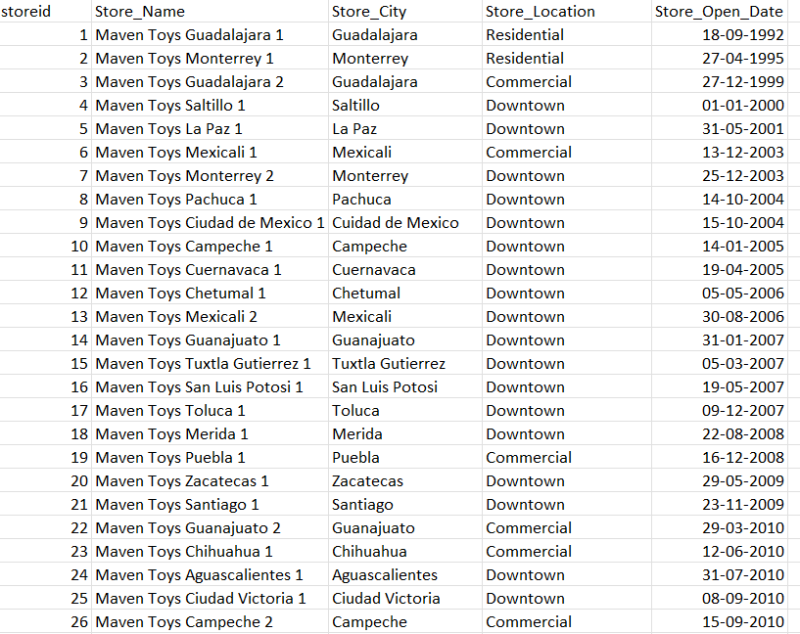
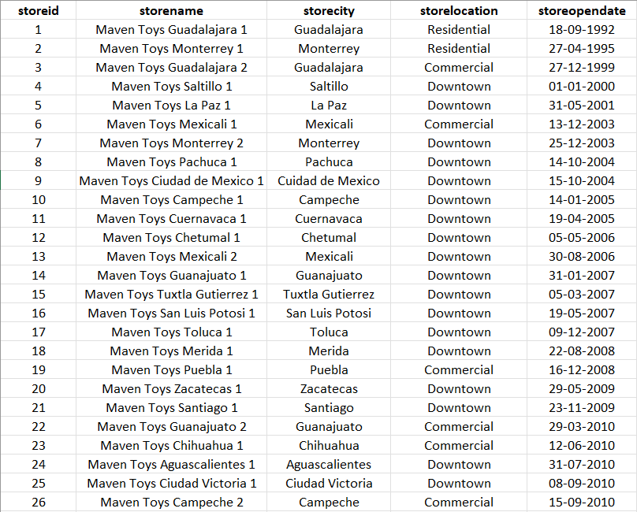

procedure
Remove any blank rows/columns.
Conversion of column names to lowercase and removal of special characters,
Formatting the Datatype of every variable.
Removing columns present in between numbers
Importing Data after creating database.
Removal of special characters with conversion to lowercase and organising data

Slide 5
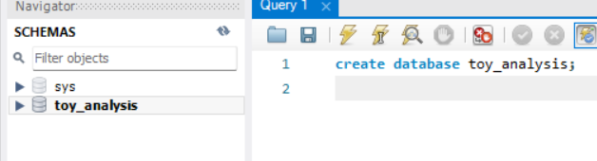
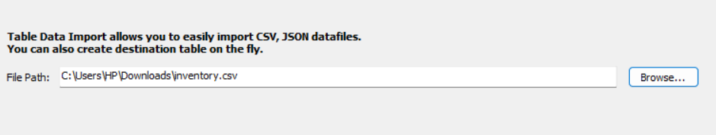
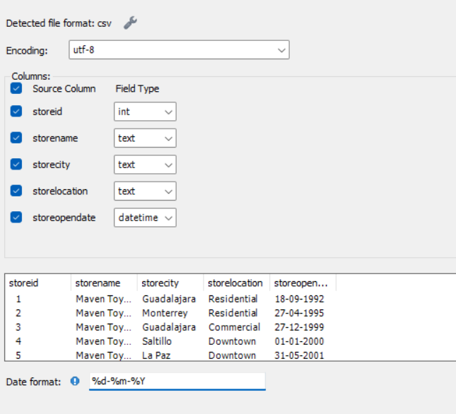
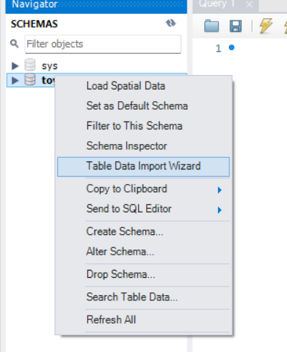
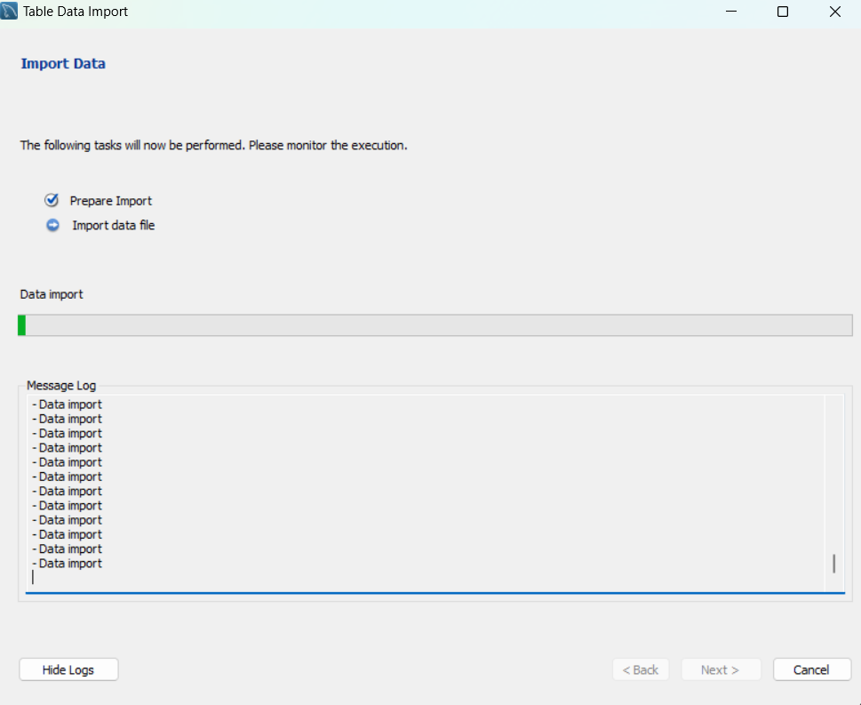
procedure
1. Creating Database
Remove any blank rows/columns.
Conversion of column names to lowercase and removal of special characters,
Formatting the Datatype of every variable.
Removing columns present in between numbers
Importing Data after creating database.
3. Setting Path
2. Import Table Data
5. Importing Data
4. Formatting Datatype

Slide 6
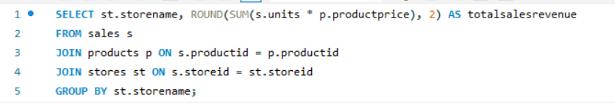
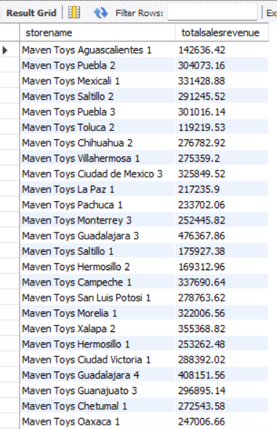
1. What is the total sales revenue generated by each store?

Slide 7
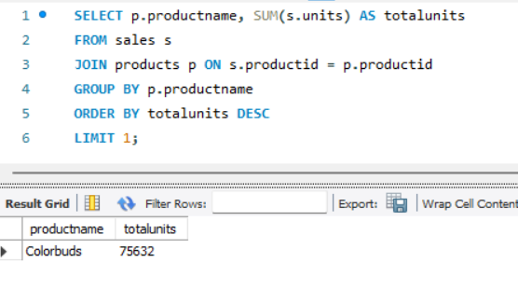
2. Which products are the top-selling in terms of units sold?

Slide 8
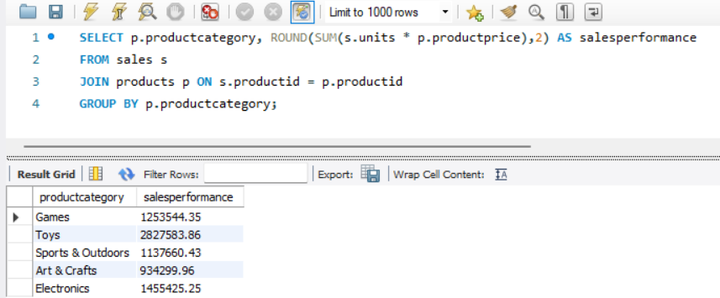
3. What is the sales performance by product category?

Slide 9
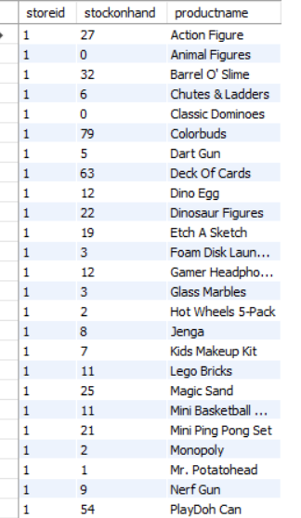
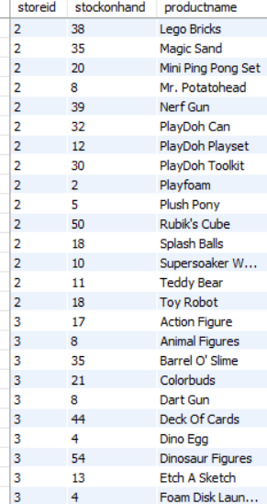

4. What are the current inventory levels for each product at each store?

Slide 10
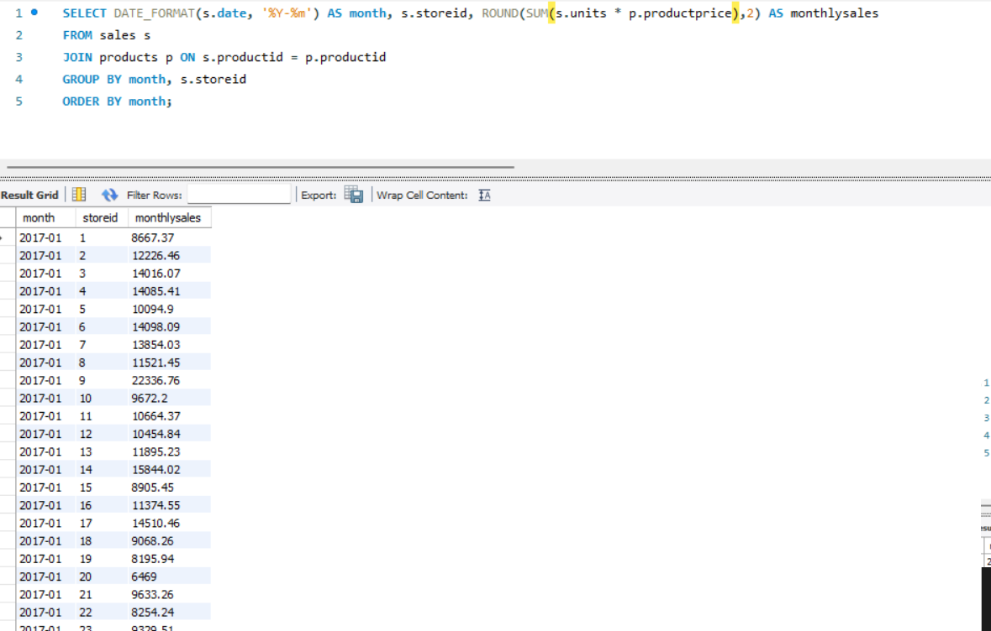
5. How do monthly sales trends vary across different stores?

Slide 11
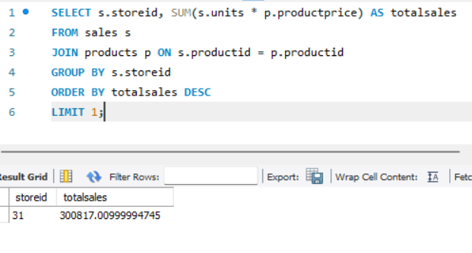
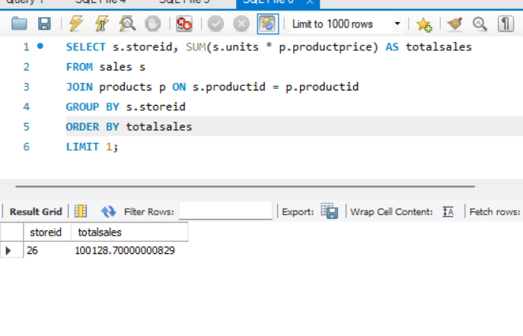
6. Which stores have the highest and lowest sales performance?
Highest
Lowest

Slide 12
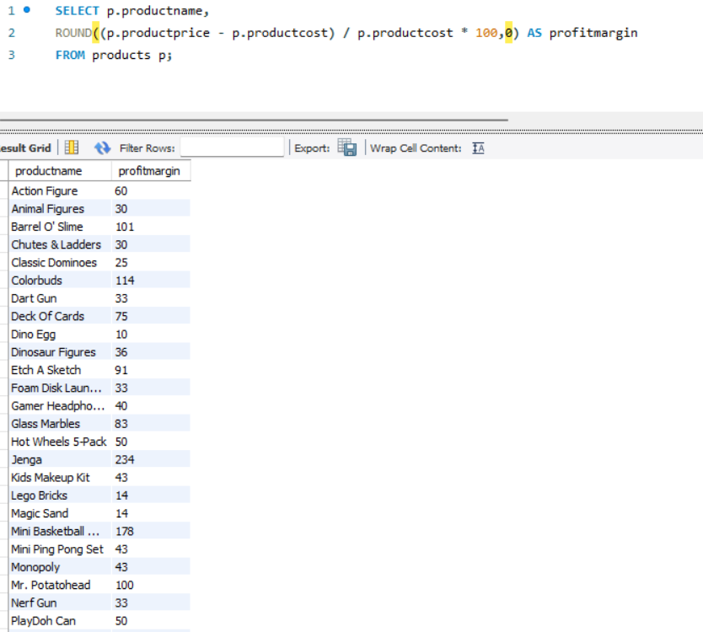
7. What is the profit margin for each product?

Slide 13
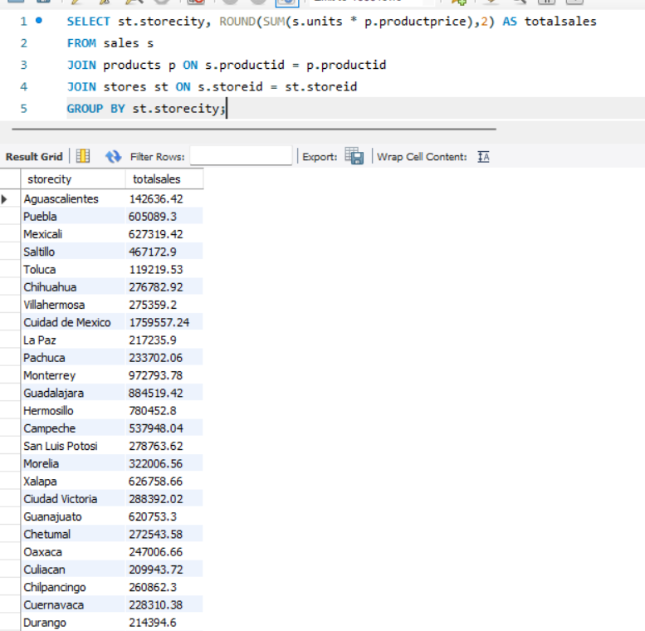
8. How are sales distributed across different cities?

Slide 14
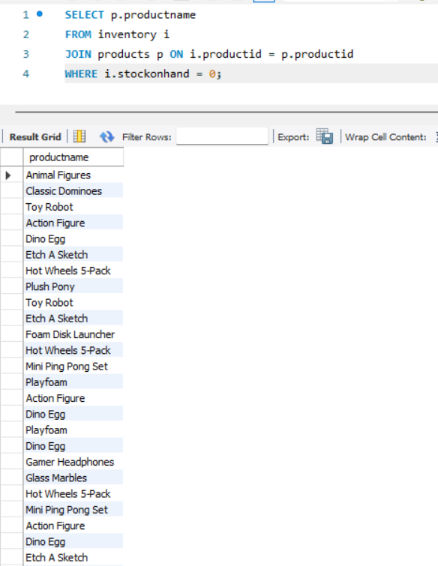
9. Which products are out of stock in each store?

Slide 15
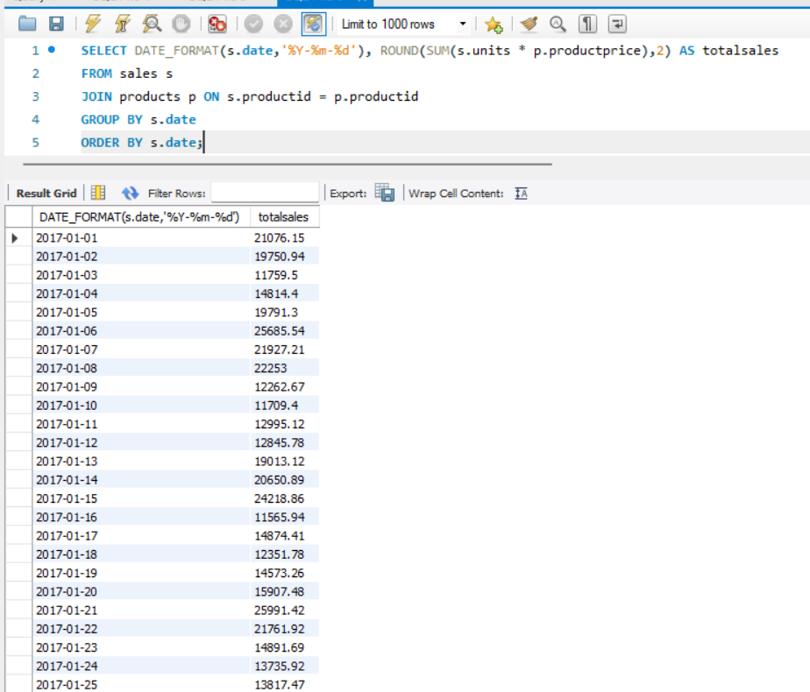
10. How do sales vary by specific dates?

Slide 16
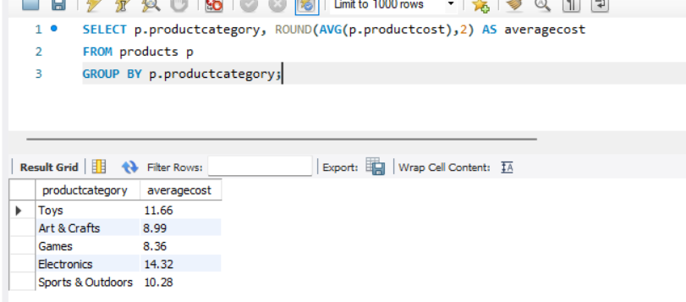
11. What is the average cost of products in each category?

Slide 17
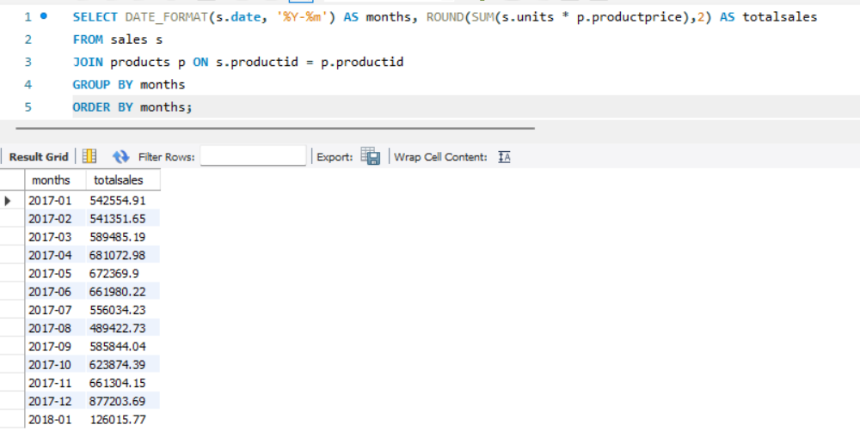
12. What is the sales growth over time for the entire company?

Slide 18
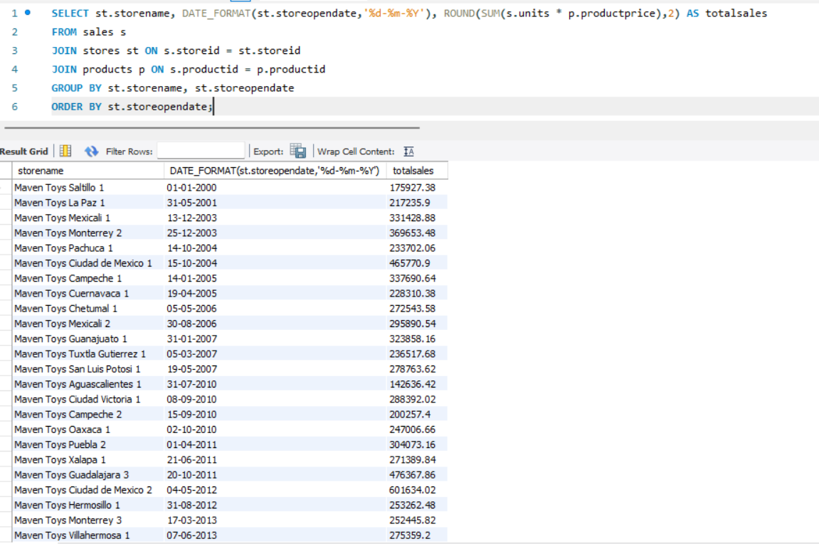
13.How does the store open date affect sales performance?

Slide 19
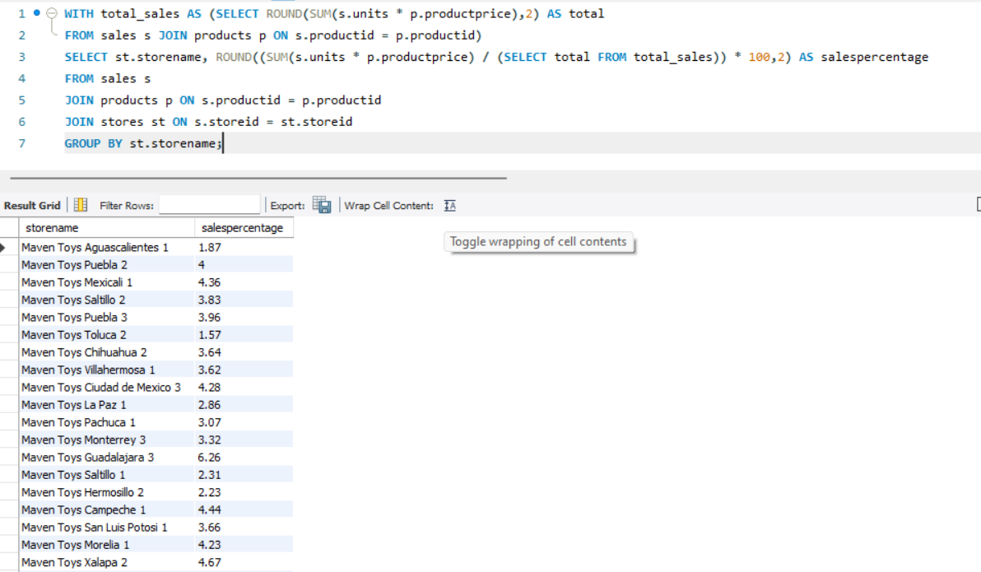
14. What percentage of total sales does each store contribute?

Slide 20
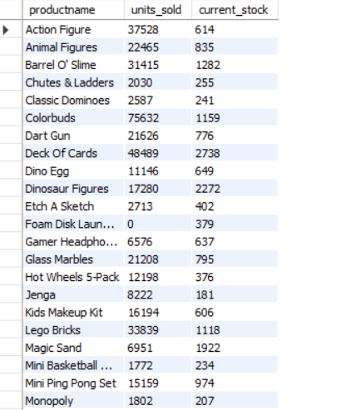
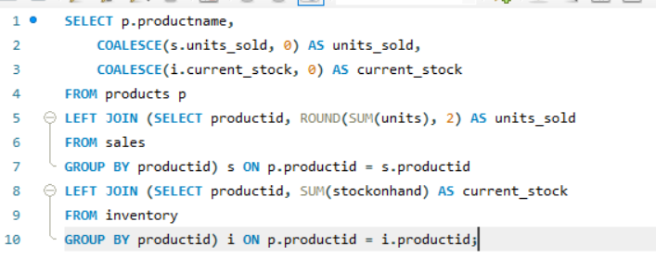
15. How do sales compare to current stock levels for each product?

Slide 21
Importance of this task
What is the total sales revenue generated by each store? Helps in identifying top-performing stores and optimizing resources.
2. Which products are top-selling in terms of units sold? Provides insight into which products need more stock or focus.
3. What is the sales performance by product category? Allows the business to invest more in profitable categories.
4. What are the current inventory levels for each product at each store? Helps in managing stock levels to avoid stockouts.

Slide 22
Challenge:
The dataset was large, consisting of over 8 lakh rows, which caused delays during data import.
How I Overcame It:
I handled the challenge by being patient and waiting for over 3 hours for the data to import into MySQL successfully.

Slide 23
conclusion
The analysis revealed significant revenue disparities across stores, with certain product categories, such as educational toys, leading in sales. Inventory issues, including frequent stockouts, highlighted the need for better stock management. Tailoring marketing efforts based on city-specific sales data could boost underperforming locations. Focusing on high-demand products will maximize overall revenue growth.

Slide 24
Thank you

